Slide 1

Git & GitHub
Git & GitHub

Slide 2
What are we going to learn ?
● What is Version Control System(VCS) ?
● Benefits of VCS
● Types of VCS
● What is Git
● Architecture of git
● Git Workflows
● Git Operations
● Git Commands
● Branching and Merging in Git
● Resolving merge conflicts
● Stashing in Git
● Git Revert
● Git Reset

Slide 3
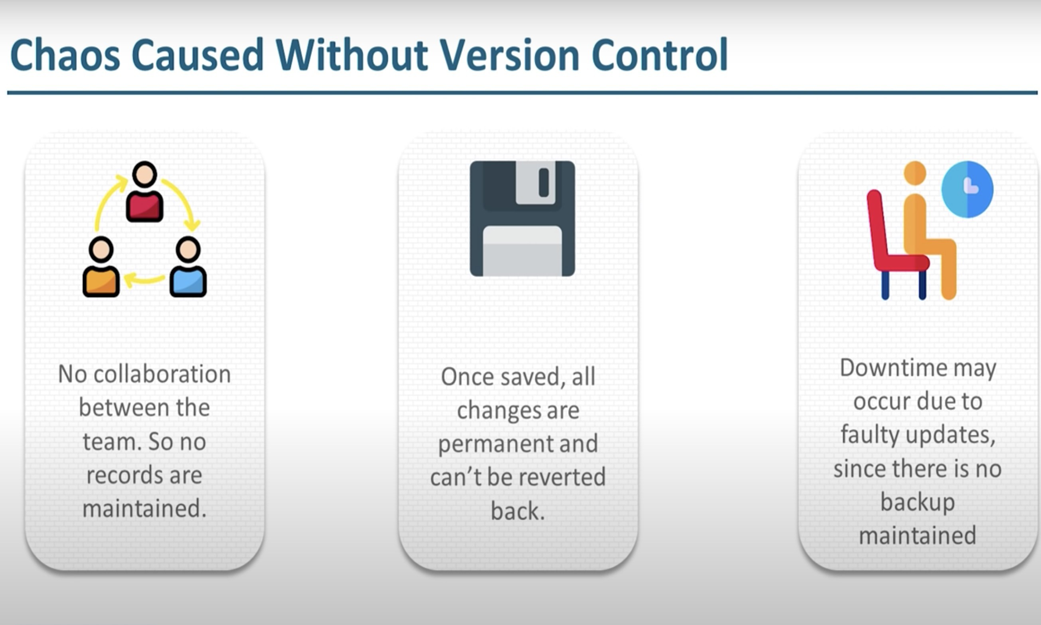
Chaos Caused Without Version Control
.

Slide 4
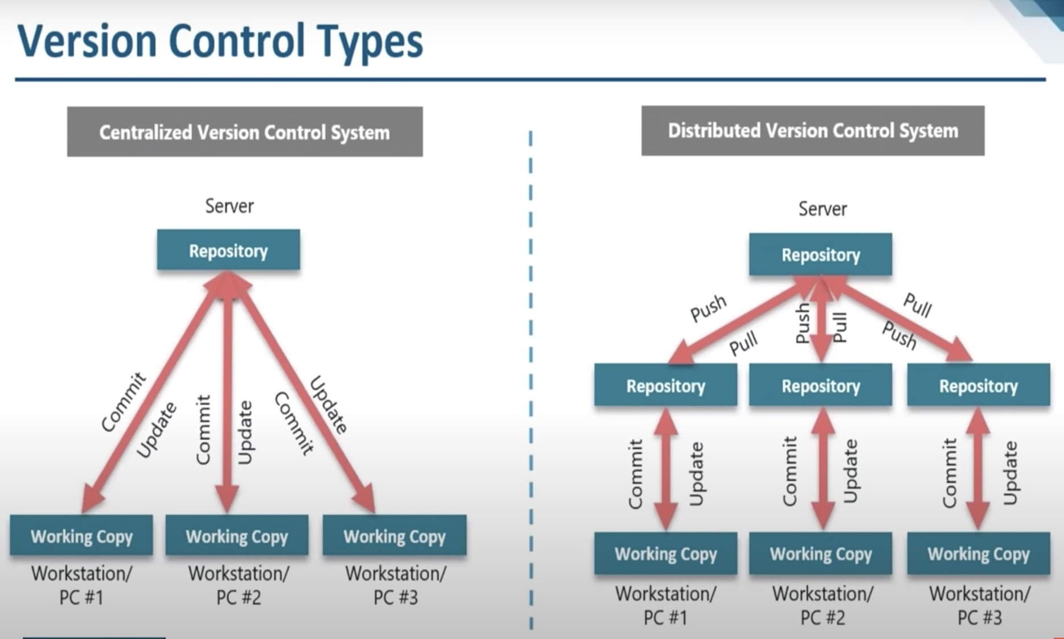
Version Control Types
.

Slide 5
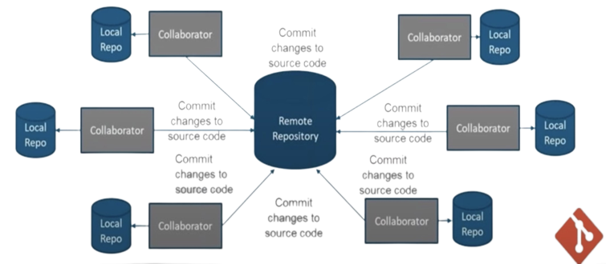
What is Git
Git is an open source Distributed Version Control System (DVCS) Which records changes made to the files laying emphasis on speed, data integrity and distributed, non-linear workflows.

Slide 6
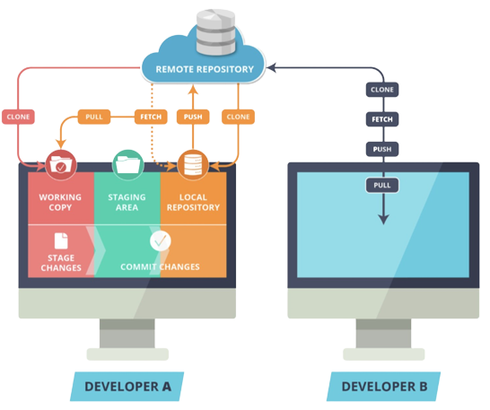
What is Git ?
.

Slide 7
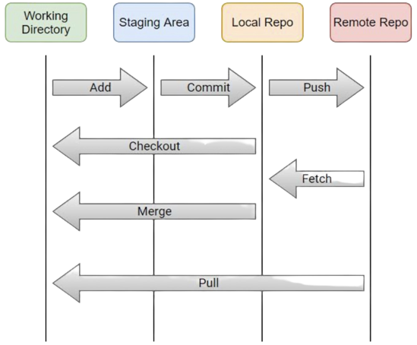
What is Git ?
.

Slide 8
Git Commands
1. git init - to initialize a git repository
2. git configure - to add git configuration
3. git add - to add files from working directory to staging area
4. git status - to review the status of files in staging area
5. git commit -m “message” - to commit the files in local repository
6. git remote add origin <remote repo url> - to configure remote repository in local git client
7. git push origin master - to push changes from local repository to remote repository
8. git pull origin master - to pull changes from remote repository to local repo as well as working dir.
9. git fetch - to fetch changes from remote repository to local repository
10.git merge - to merge from different branches in working directory.
11.git clone <remote repo url> - to replicate the remote repository in developer machine from scratch.
12.git revert <commit id> : To revert changes of a particular commit
13.git reset --soft/--mixed/--hard <commit id> : To reset the HEAD to any of the previous commit.

Slide 9
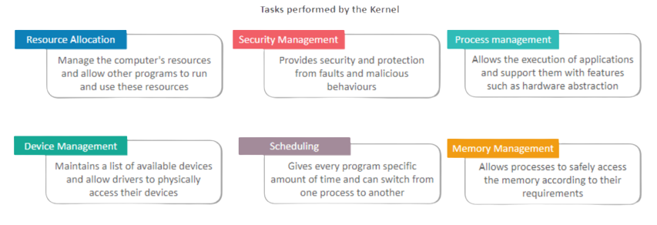
Kernel
The kernel is the interface between the applications and the actual process done at the hardware level.

Slide 10




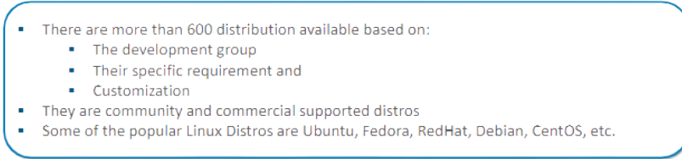
What is Linux Distribution ?
It is an Operating system having linux kernel and GNU Tools packaged with some more application.

Slide 11
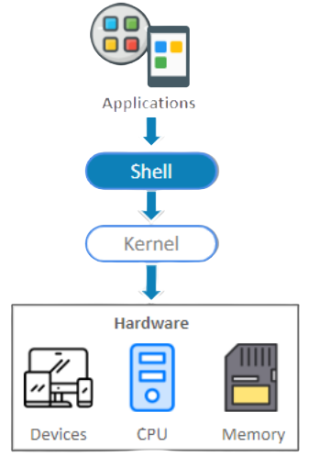
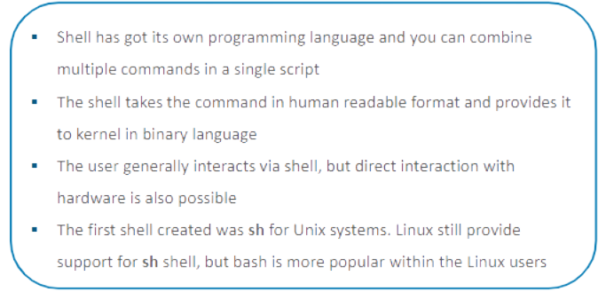
Shell
The Shell is the interface which takes user-commands and sends it to the kernel

Slide 12
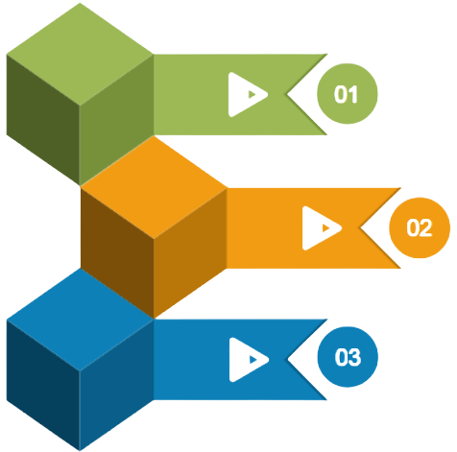
Distinguishing Factors For Linux Distro
Enterprise users or home users
Home user distro has user-friendly GUI and it is easy to use
Enterprise edition gives more importance to performance
Hardware support
Most of the distros are portable to multiple hardware, but some of
them are designed for specific vendors
Designed for Servers, Desktops and Embedded devices
Server distro generally don't have a GUI
Some of the packages of server distro are different from desktop distro

Slide 13
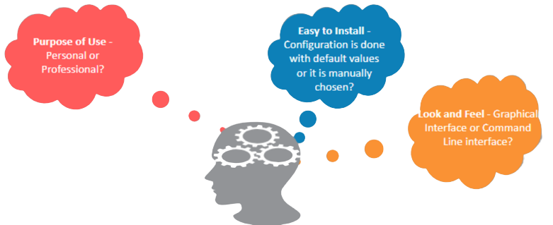
How to choose Distro?
The Distro should be chosen based on the requirement of the user
For this training it is recommended to use ubuntu

Slide 14
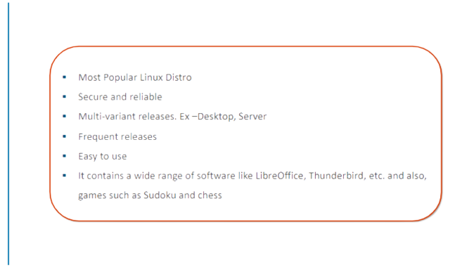
Ubuntu
.

Slide 15
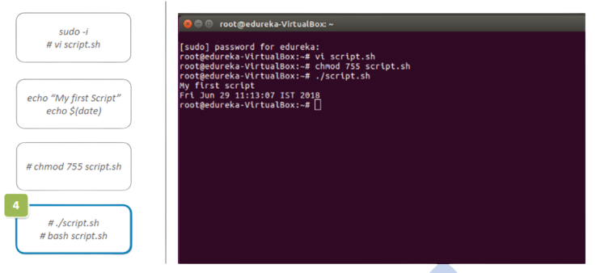
Creating A Shell Script
.

Slide 16
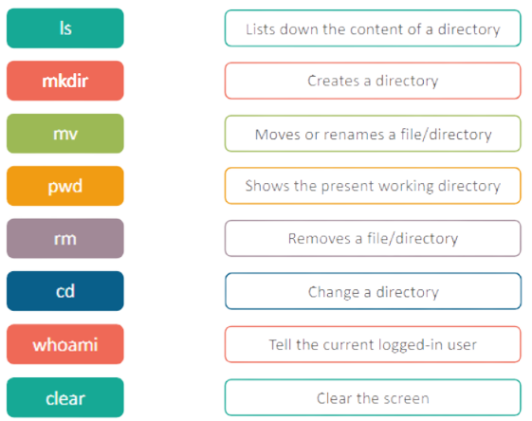
Basic Linux Commands
.

Slide 17
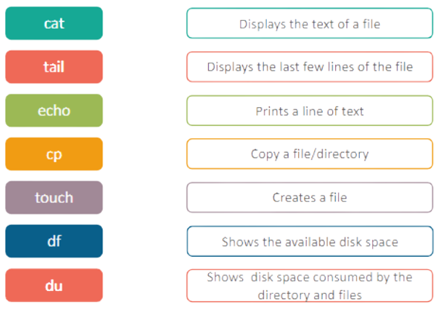
Basic Linux Commands
.

Slide 18
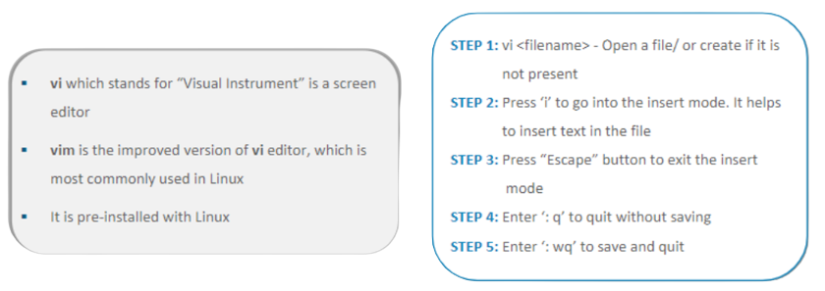
Vim Editor
.

Slide 19
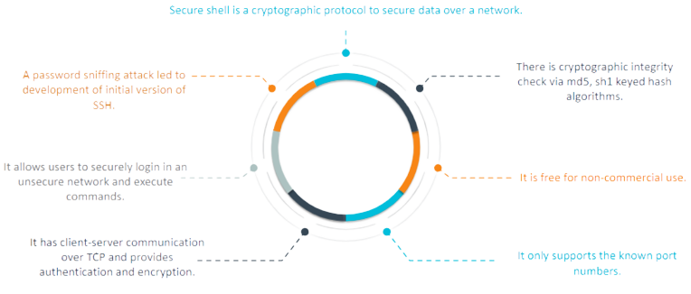
SSH

Slide 20
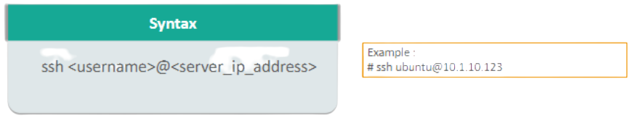
SSH Session
A client-server model is used during establishment of connection between two parties and encrypt the data between them
A SSH session works in two stages:
To sync the encryption to be used for any further communication
To authenticate the user for access rights to be given
The server waits on the configured port for connections
The client initiates the TCP handshake with the server

